Slide 1
Core Spring

Slide 2
Testing Spring Applications
Chapter 7

Slide 3
Objectives
Explain the concepts of Test Driven Development
Write tests using JUnit 5
Write Integration Tests using Spring
Configure Tests using Spring Profiles
Extend Spring Tests to work with Databases

Slide 4
Chapter Topics
Test Driven Development
JUnit 5
Integration Testing With Spring
Testing With Profiles
Testing With Databases
Unit Testing With Stubs And Mocks (Optional)
Summary
References
Review
Lab

Slide 5
What Is Test Driven Development (TDD)?
TDD = Test Driven Development
  Is it writing tests before the code?
  Is it writing tests at the same time as the code?
  Ultimately that is not what is most important
TDD is about:
  Writing automated tests that verify code actually works
  Driving development with well defined requirements in the form of tests
Ultimately, Test Driven Development is about ensuring each functional unit works, using code which exercises that functional unit to verify its behaviour or output is correct

Slide 6
But I Don't Have Time To Write Tests. I've Got A Deadline!
Actually, my preferred excuse for not writing tests is “I just prefer to write error-free code” ;-)
Every development process includes testing
  Either automated or manual
  Intentional (in the form of unit and integration tests)
  Unintentional (in the form of debugging, an expensive form of manual testing)
  “You can pay me now, or you can pay me later”
Automated tests result in a faster development cycle overall
  Testing tools are faster than you are (once you master them)
Properly done TDD is faster than development without tests

Slide 7
TDD, Refactoring And Agility
Comprehensive test coverage provides confidence
Confidence enables refactoring
Refactoring is essential to agile development

Slide 8
TDD And Design
Testing makes you think about your design
If your code is hard to test, then, perhaps, the design should be reconsidered

Slide 9
TDD And Focus
Test cases help you prioritize and focus on what matters
  Often eliminating code you don't need
Find problems early
  When the cost of fixing them is small
  Before they become integrated into the larger system

Slide 10

Benefits Of Agile, Continuous Integration
The cost to fix a bug grows exponentially in proportion to the time before it is discovered
Continuous Integration (CI) focuses on reducing the time before the bug is discovered
  Effective CI requires automated tests
Time To Fix
Time Until Discovered

Slide 11
Chapter Topics
Test Driven Development
JUnit 5
Integration Testing With Spring
Testing With Profiles
Testing With Databases
Unit Testing With Stubs And Mocks (Optional)
Summary
References
Review
Lab

Slide 12
What Is JUnit 5?
JUnit 5 = JUnit Platform + JUnit Jupiter + JUnit Vintage
  JUnit Platform
    A foundation for launching testing frameworks on the JVM
  JUnit Jupiter
    Defines a new programming model and extension model for writing tests and extensions in JUnit 5
  JUnit Vintage
    A TestEngine for running JUnit 3 & 4 tests on the JUnit 5 platform
JUnit 5 requires Java 8 (or higher) at runtime
  Leverages Lambdas

Slide 13
JUnit 5: New Programming Models
JUnit 5 replaces many JUnit 4 annotations
JUnit 5 also introduces new annotations
  @DisplayName
  @Nested
  @ParameterizedTest
  ...
JUnit 4 | JUnit 5
@Before | @BeforeEach
@BeforeClass | @BeforeAll
@After | @AfterEach
@AfterClass | @AfterAll
@Ignore | @Disabled

Slide 14
Writing Test Code: JUnit 5 Style
import static org.junit.jupiter.api.Assertions.fail;
import org.junit.jupiter.api.AfterAll;
import org.junit.jupiter.api.AfterEach;
import org.junit.jupiter.api.BeforeAll;
import org.junit.jupiter.api.BeforeEach;
import org.junit.jupiter.api.Disabled;
import org.junit.jupiter.api.Test;
class StandardTests {
@BeforeAll // Execute before all tests
static void initAll() {...}
@BeforeEach // Execute before each test
void init() {...}
@Test
void succeedingTest() {...}
@Test
void failingTest() {
fail("A failing test");
}
@Test
@Disabled("for demo purposes") // Don't run this test
void skippedTest() {
// Not executed
}
}

Slide 15
JUnit 5: New Programming Assertions
JUnit 5 introduces new assertions
  assertThrows(<exception.class>, <lambda-expression>)
  assertTimeout(<duration>, <lambda-expression>)
  assertAll(<description>, <multiple-assertions>)
Improves assumptions
  Uses lambda expressions to represent the code being tested

Slide 16
Example: assertThrows() And assertTimeout()
@Test
void exceptionTesting() {
Throwable exception = assertThrows(
IllegalArgumentException.class,
() -> {
// Perform a task that throws an illegal argument exception
}
);
assertEquals("Some error message", exception.getMessage());
}
@Test
void timeoutNotExceeded() {
// The following assertion succeeds.
assertTimeout(
OfMinutes(2),
() -> {
// Perform a task that takes less than 2 minutes
}
);
}

Slide 17
Example: Using Lambdas And assertAll()
@Test
void standardAssertions() {
assertEquals(2, 2);
assertEquals
(4, 4, "Optional assertion message is now last parameter.");
assertTrue(
2 == 2,
() ->
"Assertion messages can be lazily evaluated -- "
+ "to avoid constructing complex messages unnecessarily."
);
}
@Test
void groupedAssertions() {
// In a grouped assertion all assertions are executed, and any
// failures will be reported together.
assertAll("person",
() -> assertEquals("John", person.getFirstName()),
() -> assertEquals("Doe", person.getLastName())
);
}

Slide 18
Assumptions
@Test void testOnlyOnCiServer() {
assumeTrue("CI".equals(System.getenv("ENV")));
// Remainder of test evaluated only if assumption true
}
@Test void testOnlyOnDeveloperWorkstation() {
assumeTrue("DEV".equals(System.getenv("ENV")),
() -> "Aborting test: not on developer workstation");
// Remainder of test evaluated only if assumption true
}
@Test void testInAllEnvironments() {
assumingThat(
"CI".equals(System.getenv("ENV")),
() -> {
// Perform these assertions only on the CI server
assertEquals(2, 2);
}
);
// Perform these assertions in all environments
assertEquals("Some string", "Some other string");
}

Slide 19
Chapter Topics
Test Driven Development
JUnit 5
Integration Testing With Spring
Testing With Profiles
Testing With Databases
Unit Testing With Stubs And Mocks (Optional)
Summary
References
Review
Lab

Slide 20
Unit Testing
Unit Testing
  Tests one unit of functionality
  Keeps dependencies minimal
  Isolated from the environment (including Spring)
  Uses simplified alternatives for dependencies
    Stubs and/or Mocks
    More on this later
Spring's test framework offers limited benefits for Unit Testing
  e.g. Dependency injecting a stub or mock

Slide 21
Integration Testing
Integration (System) Testing
  Tests the interaction of multiple units working together
    Each should work individually
      In other words, each should have already passed a Unit test
Tests your application classes in the context of their interactions with one another and with the surrounding infrastructure
  Performs out-of-container testing, so no need to run up full JEE system to perform a test
  Infrastructure may easily be “scaled down” to the needs of the test environment
    e.g. Use Apache's DBCP connection pool instead of container-provider pool obtained through JNDI
    e.g. Use ActiveMQ to save expensive commercial messaging server licenses
Spring's test framework offers extensive benefits for Integration Testing

Slide 22
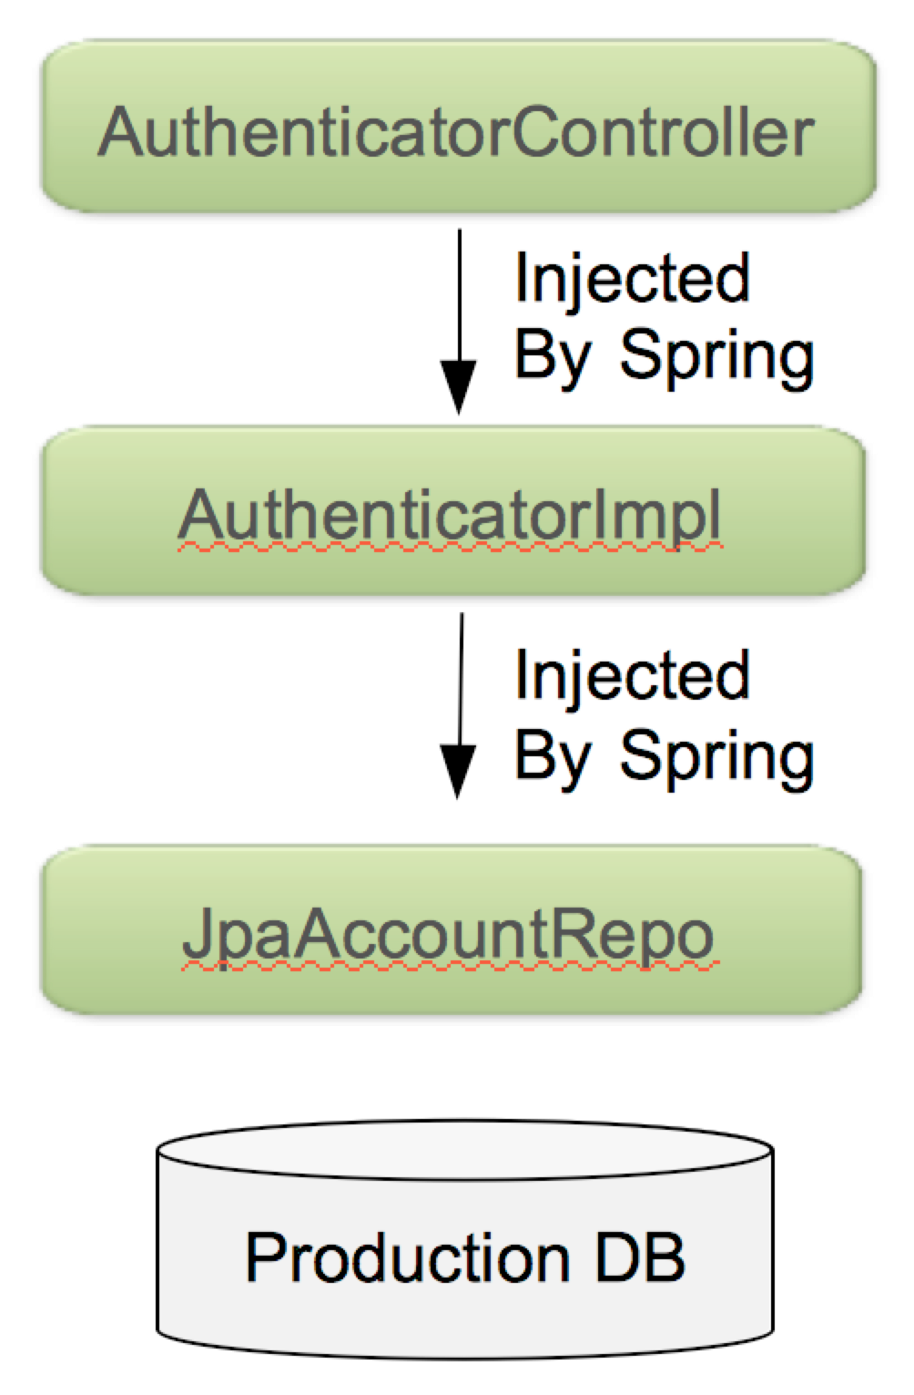
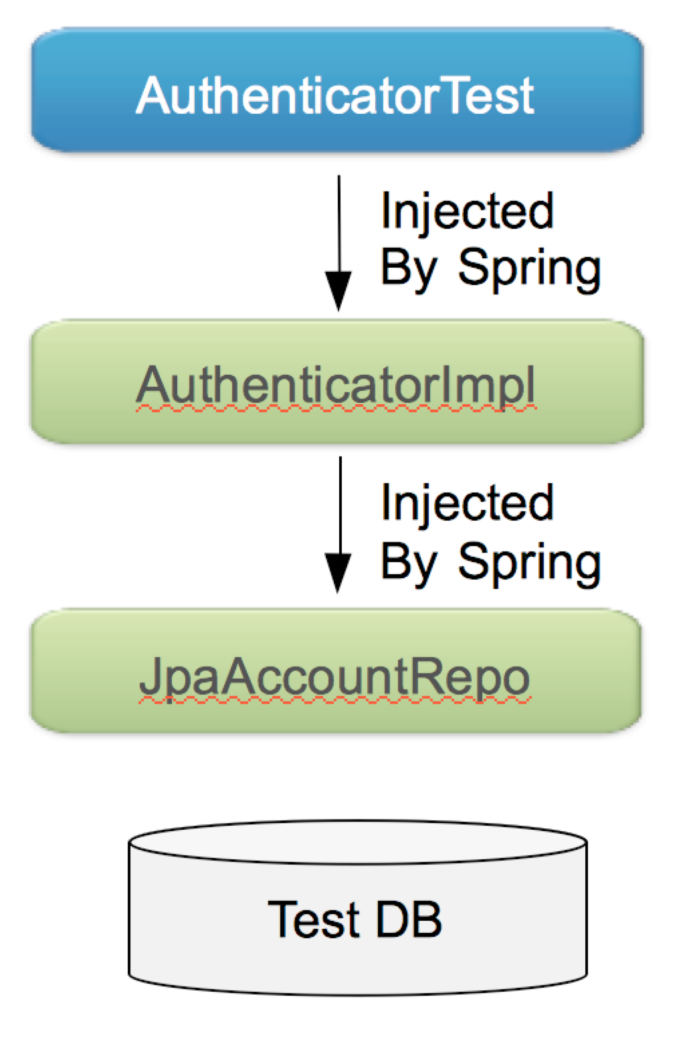
Example: Integration Testing
Production Mode | Integration Test

Slide 23
Spring's Integration Test Support For JUnit 5
JUnit supports all of Core Spring TestContext Framework features
  Constructor/method injection via
    @Autowired
    @Qualifier
    @Value
  @ExtendWith(SpringExtension.class)
  @SpringJUnitConfig
Packaged as a separate module
  spring-test.jar
Consists of several JUnit test support classes

Slide 24
@ExtendWith In JUnit 5
JUnit 5 has an extensible architecture which can be exploited via the @ExtendWith annotation
  So you are no longer limited to using just one extension on a Test Class
    As was the case with JUnit 4
Example
  ParameterResolver
    Dynamically resolve parameters at runtime

Slide 25
@ExtendWith(SpringExtension.class)
Integrates the Spring TestContext Framework into JUnit 5’s Jupiter programming model
  By replacing JUnit 4's @RunWith
  with
  @RunWith(SpringRunner.class)
Serves as a ParameterResolver implementation
  Resolves requested parameter dependency against Spring's ApplicationContext
  Dependencies can be specified as arguments of test method

Slide 26
@SpringJUnitConfig
@SpringJUnitConfig is a “composed” annotation (MetaAnnotation) designed to make test creation easier and faster by combining the features of
  @ExtendWith(SpringExtension.class) from JUnit Jupiter
    Runs the test with the SpringExtension class
  @ContextConfiguration from the Spring TestContext Framework
    Loads the Spring context

Slide 27
Using Spring's Test Support
@ExtendWith(SpringExtension.class)
@ContextConfiguration(classes=SystemTestConfig.class)
public final class TransferServiceTests {
@Autowired
private TransferService transferService;
@Test
public void shouldTransferMoneySuccessfully() {
TransferConfirmation conf = transferService.transfer(...);
...
}
}
@ExtendWith(SpringExtension.class)
  Run this test with Spring support
    e.g. Dependency Injection, AOP, Component Scanning
@ContextConfiguration
  Tells Spring where to find the configuration files containing the bean definitions
Less need for @BeforeEach than in a typical JUnit test, if initializing state independently of the ApplicationContext

Slide 28
An Alternative Approach Using @SpringJUnitConfig
@SpringJUnitConfig(classes=SystemTestConfig.class)
public final class TransferServiceTests {
// @Autowired
// private TransferService transferService;
@Test
public void shouldTransferMoneySuccessfully
(@Autowired TransferService transferService) {
TransferConfirmation conf = transferService.transfer(...);
...
}
}
Instead of Autowiring the dependency as a data-member, it can be passed to the test method directly
  This is a nice way to localize test dependencies

Slide 29
Using JUnit4 To Run JUnit 5 Test Code
@RunWith(JUnitPlatform.class)
  Provides backwards compatibility
    Allows tests to be run with IDEs and build systems that support JUnit 4, but do not yet support the JUnit 5 Platform directly
@RunWith(JUnitPlatform.class)
@ExtendWith(SpringExtension.class)
@ContextConfiguration(classes=SystemTestConfig.class)
public final class TransferServiceTests {
@Test
public void shouldTransferMoneySuccessfully
(@Autowired TransferService transferService) {
TransferConfirmation conf = transferService.transfer(...);
...
}
}

Slide 30
Including Configuration As An Inner Class
@ExtendWith(SpringExtension.class)
@ContextConfiguration // No external Configuration class
public class JdbcAccountRepoTest {
private JdbcAccountRepo repo = ...;
@Test
public void shouldUpdateDatabaseSuccessfully() {...}
@Configuration
@Import(SystemTestConfig.class)
static class TestConfiguration {
@Bean public DataSource dataSource() {...}
}
}

Slide 31
Multiple Test Methods
@SpringJUnitConfig(classes=SystemTestConfig.class)
public class TransferServiceTests {
@Autowired
private TransferService transferService;
@Test
public void successfulTransfer() {
...
}
@Test
public void failedTransfer() {
...
}
}
Spring's SystemTestConfig class instantiates the ApplicationContext only once for all tests, caching and reusing the same set of config files across test methods and test classes
  Most Spring beans are stateless/immutable, so avoiding the cost of reloading the ApplicationContext across test methods is reasonable

Slide 32
But What If A Test Method Alters The State Of A Bean?
Spring provides a @DirtiesContext annotation that forces the ApplicationContext to be closed at the end of any test method labeled with this annotation
  This is one way to test @PreDestroy behavior
The next test to execute gets a new ApplicationContext
  Which is cached for subsequent tests
@Test
@DirtiesContext
public void testTransferLimitExceeded() {
transferService.setMaxTransfers(0);
...
}

Slide 33
Test Property Sources
You can define custom properties just for testing
  Inline or in property files
  Specify one or more properties
    These will override any existing properties of same name
  Specify the location of one or more properties files to load
    Defaults to looking for [classname].properties
Order of precedence (if a property is defined in multiple locations)
  Properties specified by the properties attribute
  Properties specified in the location file
  Properties defined elsewhere
@SpringJUnitConfig(classes=SystemTestConfig.class)
@TestPropertySource(properties = {
"username=foo", "password=bar"
}
locations = "classpath:/transfer-test.properties"
)
public class TransferServiceTests {...}

Slide 34
Benefits Of Testing With Spring
No need to deploy to an external container to test application functionality
  You can run everything quickly inside your IDE
  Supports Continuous Integration testing
Allows reuse of your configuration between test and production environments
  Application configuration logic is typically reused
  Infrastructure configuration tends to be environment-specific
    DataSources
    JMS Queues

Slide 35
Chapter Topics
Test Driven Development
JUnit 5
Integration Testing With Spring
Testing With Profiles
Testing With Databases
Unit Testing With Stubs And Mocks (Optional)
Summary
References
Review
Lab

Slide 36
Activating Profiles For A Test
Use @ActiveProfiles inside the test class
  Define one or more profiles to be activated
  Beans associated with that profile are instantiated
  Beans not associated with any profile are also instantiated
  Beans NOT (!) associated with unspecified profiles are also instantiated
Example
  Two profiles activated
    jdbc
    dev
@SpringJUnitConfig(classes=DevConfig.class)
@ActiveProfiles({"jdbc","dev"})
public class TransferServiceTests {...}

Slide 37
Activating Profiles With JavaConfig
Use @ActiveProfiles inside the test class
Use @Profile inside an @Configuration class
@SpringJUnitConfig(classes=DevConfig.class)
@ActiveProfiles("jdbc")
public class TransferServiceTests {...}
@Configuration
@Profile("jdbc")
public class DevConfig {
@Bean public DataSource dataSource() {...}
}

Slide 38
Activating Profiles With Annotations
Use @ActiveProfiles inside the test class
Use @Profile inside an @Component class
  Or one of its stereotypes
@SpringJUnitConfig(classes=DevConfig.class)
@ActiveProfiles("jdbc")
public class TransferServiceTests {...}
@Repository
@Profile("jdbc")
public class JdbcAccountRepository {
@Bean
public AccountRepository accountRepository() {...}
}

Slide 39
Chapter Topics
Test Driven Development
JUnit 5
Integration Testing With Spring
Testing With Profiles
Testing With Databases
Unit Testing With Stubs And Mocks (Optional)
Summary
References
Review
Lab

Slide 40
Testing With Databases
Integration testing against SQL database is common
In-memory databases are useful for this kind of testing
  No prior installation required
  But how do you populate the database with records?
    Use the @Sql annotation
    This annotation runs the designated sql script before executing the test method
@Test
@Sql("/testfiles/test-data.sql")
public void successfulTransfer() {
...
}

Slide 41
@Sql Examples
@SpringJUnitConfig(...)
@Sql({
"/testfiles/schema.sql", "/testfiles/general-data.sql"
})
public class MainTests {
@Test
@Sql
public void success() {...}
@Test
@Sql("/testfiles/error.sql")
@Sql(scripts="/testfiles/cleanup.sql",
executionPhase=Sql.ExecutionPhase.AFTER_TEST_METHOD)
public void transferError() {...}
}
Run before each @Test method
Run MainTests.success.sql
from the same package
Run before the @Test method
Run after the @Test method

Slide 42
@Sql Options
When does the SQL run?
  executionPhase: before (default) or after the test method
  config: SqlConfig has many options to control SQL scripts
    What to do if script fails?
      FAIL_ON_ERROR
      CONTINUE_ON_ERROR
      IGNORE_FAILED_DROPS
      DEFAULT*
        Whatever @SQL defines at the class level, otherwise FAIL_ON_ERROR
    SQL syntax control
      Comments
      Statement separator
@Sql(scripts = "/test-user-data.sql",
executionPhase = ExecutionPhase.AFTER_TEST_METHOD,
config = @SqlConfig(
errorMode = ErrorMode.FAIL_ON_ERROR,
commentPrefix = "//",
separator = "@@"
)
)

Slide 43
Chapter Topics
Test Driven Development
JUnit 5
Integration Testing With Spring
Testing With Profiles
Testing With Databases
Unit Testing With Stubs And Mocks (Optional)
Summary
References
Review
Lab

Slide 44
Unit Testing
To conduct Unit tests you must simulate dependencies
  A test of some component should only fail due to a fault in the component itself, not due to a fault in some other component on which the component being tested depends
Techniques for isolating dependent components from the components being tested:
  Stubs
    Write your own dependent components
  Mocks
    Generate dependent components using an automated framework

Slide 45
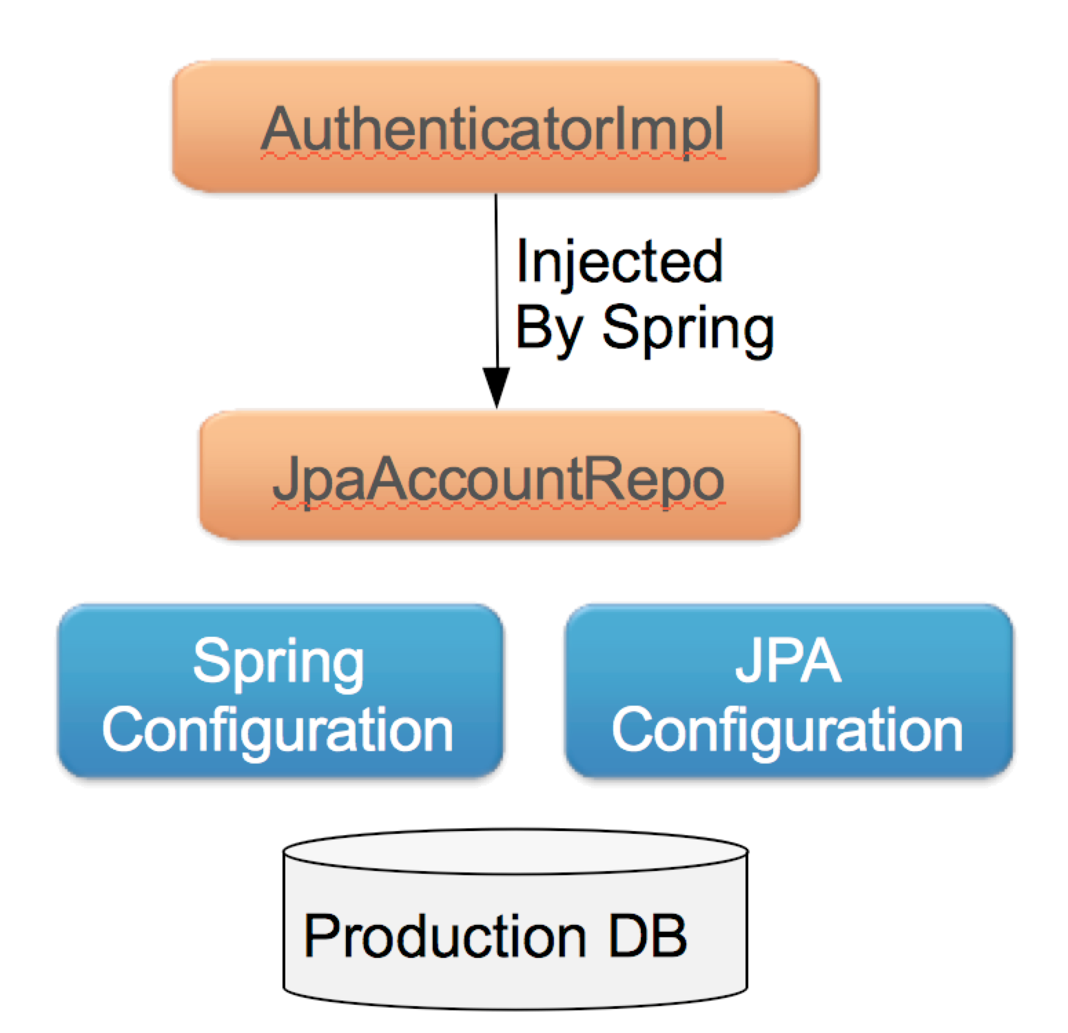
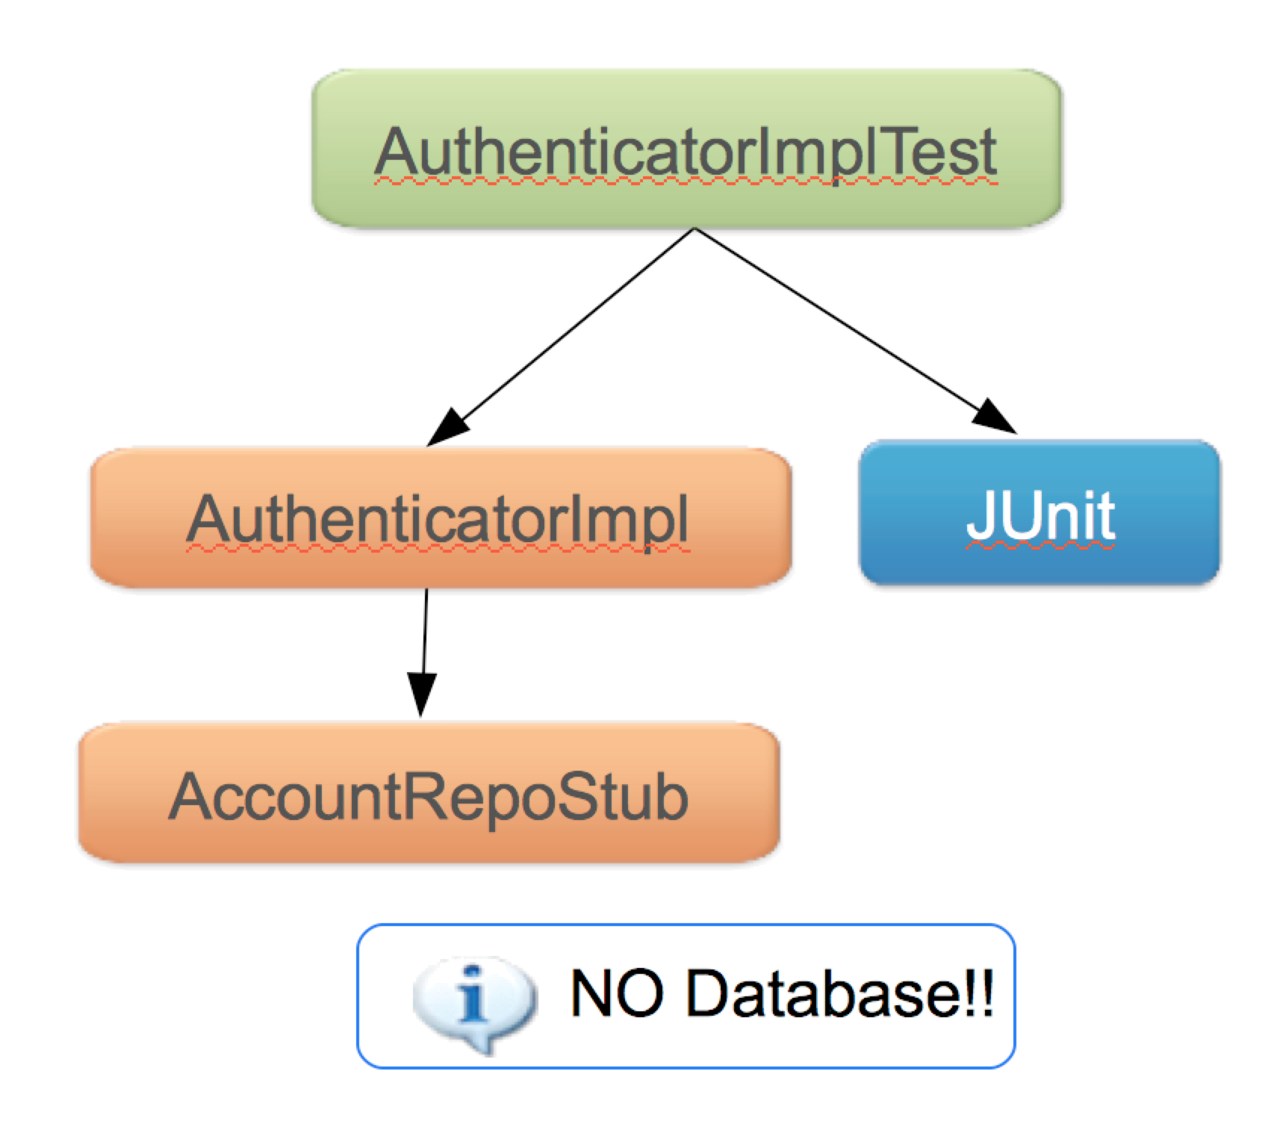
Unit Testing Example
Production Mode | Unit Test With Stubs

Slide 46
Unit Being Tested
public class AuthenticatorImpl implements Authenticator {
private AccountRepository accountRepository;
public AuthenticatorImpl(AccountRepository accountRepository) {
this.accountRepository = accountRepository;
}
public boolean authenticate(String username, String password) {
Account account = accountRepository.getAccount(username);
return account.getPassword().equals(password);
}
}
Objective
  To inject a different repository when testing than the one injected in a production environment

Slide 47
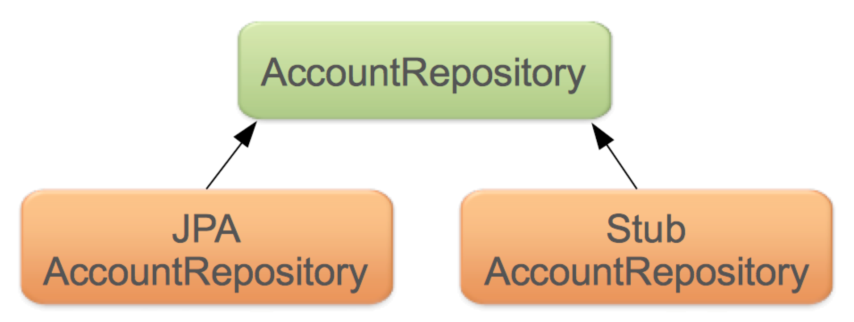
Implementing A Stub
Create the Stub class manually
  A stub is a “fake” component that simulates the behavior of a properly coded dependency
    Contains little or no real business logic
  Implements the business interface of the component being isolated from the component being tested
public class StubAccountRepository implements AccountRepository {
public Account getAccount(String user) {
return "lisa".equals(user) ? new Account("lisa", "secret") : null;
}
}
For the record, returning a null value here will cause the authenticate
method from the previous slide to throw a NullPointerException.

Slide 48
Unit Test Using A Stub
import org.junit.Before;
import org.junit.Test;
public class AuthenticatorImplTests {
private AuthenticatorImpl authenticator;
@Before public void setUp() {
authenticator = new AuthenticatorImpl
(new StubAccountRepository()); // Inject a Stub
}
@Test public void successfulAuthentication() {
assertTrue(authenticator.authenticate("lisa", "secret"));
}
@Test public void invalidPassword() {
assertFalse(authenticator.authenticate("lisa", "invalid"));
}
}

Slide 49
Unit Testing With Stubs
Advantages
  Easy to implement and understand
  Reusable
Disadvantages
  Changes to the business interface typically require modification of the stub
  The stub must implement all methods of the business interface, even those not being tested
  If a stub is reused in subsequent tests, changing the stub could break earlier tests that relied on the previous implementation

Slide 50
Steps To Testing With A Mock
Use a mocking library to generate a mock object
  Implements the dependent interface on-the-fly
Record the mock with expectations of how it will be used in the scenario being tested
  What methods to call
  What parameters to pass
  What values to return
Exercise the scenario
Verify that your expectations were met

Slide 51
Unit Test Using EasyMock
Setup
  A Mock class is created at startup time
import static org.mockito.classextensions.EasyMock.*; // Static imports
public class AuthenticatorImplTests {
// Create mock at startup.
private AccountRepository accountRepository =
createMock(AccountRepository.class);
// Inject the mock.
private AuthenticatorImpl authenticator =
new AuthenticatorImpl(accountRepository);
@Test
public void validUserWithCorrectPassword() {
expect(accountRepository.getAccount("lisa")). // Define your
andReturn(new Account("lisa", "secret")); // expections
replay(accountRepository); // End definition
// Run the test
boolean result = authenticator.authenticate("lisa", "secret");
assertTrue(result); // Inspect the result
verify(accountRepository); // See if the method
} // was invoked
}

Slide 52
The Same Unit Test Using A Mockito
import static org.mockito.Mockito.*; // Static imports
public class AuthenticatorImplTests {
// Create mock at startup.
private AccountRepository accountRepository =
mock(AccountRepository.class);
// Inject the mock.
private AuthenticatorImpl authenticator =
new AuthenticatorImpl(accountRepository);
@Test
public void validUserWithCorrectPassword() {
when(accountRepository.getAccount("lisa")). // Define your
thenReturn(new Account("lisa", "secret")); // expections
// Run the test
boolean result = authenticator.authenticate("lisa", "secret");
assertTrue(result); // Inspect the result
verify(accountRepository); // See if the method
} // was invoked
}

Slide 53
Mock Considerations
Several mocking libraries are available
  EasyMock
  JMock
  Mockito
Advantages of using Mocks rather than Stubs
  No class to maintain
  You only need to setup what is necessary for the scenario you are testing
  Mocks test behavior as well as state
    Insuring you get the right outcome for the right reason
Disadvantages
  Can be a little harder to understand at first

Slide 54
Mocks Or Stubs
You will probably use both
General recommendations
  Favor mocks over stubs for non-trivial interfaces
  Favor stubs for simpler scenarios
Read “Mocks Aren't Stubs” by Martin Fowler
  http://www.martinfowler.com/articles/mocksArentStubs.html

Slide 55
Chapter Topics
Test Driven Development
JUnit 5
Integration Testing With Spring
Testing With Profiles
Testing With Databases
Unit Testing With Stubs And Mocks (Optional)
Summary
References
Review
Lab

Slide 56
Summary
Testing is an essential part of any development
Unit testing tests a class in isolation of its dependencies
  External dependencies should be minimized
  Consider creating stubs or mocks to unit test
  You don't need Spring to unit test
Integration testing tests the interaction of multiple units working together
  Spring provides good integration testing support
  Use profiles for different test and deployment configurations
  Spring also provides built-in support for testing with Databases

Slide 57
Chapter Topics
Test Driven Development
JUnit 5
Integration Testing With Spring
Testing With Profiles
Testing With Databases
Unit Testing With Stubs And Mocks (Optional)
Summary
References
Review
Lab

Slide 58
References
https://docs.spring.io/spring/docs/current/spring-framework-reference/testing.html
https://github.com/sbrannen/spring-test-junit5

Slide 59
Chapter Topics
Test Driven Development
JUnit 5
Integration Testing With Spring
Testing With Profiles
Testing With Databases
Unit Testing With Stubs And Mocks (Optional)
Summary
References
Review
Lab

Slide 60
Review
What are the key differences between unit and integration testing?

Slide 61
Review Answer
What are the key differences between unit and integration testing?
  Unit Testing
    Tests one unit of functionality
    Keeps dependencies minimal
    Components are isolated from
      One another
      The surrounding environment (including Spring)
  Integration Testing
    Tests the interaction of multiple units working together
    Integrates infrastructure

Slide 62
Review
What's the difference between a Stub and a Mock?

Slide 63
Review Answer
What's the difference between a Stub and a Mock?
  Stubbing a method is about replacing the method with code that returns a specified result
  Mocking a method is about asserting that a method has been called, received certain parameters and returned a particular outcome

Slide 64
Review
Describe the functionality of each of the following Spring test features
  @RunWith
  @ContextConfiguration

Slide 65
Review Answer
Describe the functionality of each of the following Spring test features
  @RunWith
    Brings Spring functionality to the process of testing
  @ContextConfiguration
    Specifies the location of resources on which the test environment depends

Slide 66
Review
One of Spring's contributions to testing is its ability to cache an ApplicationContext
  What is desirable about this?
  Under what circumstances might it not be desirable?
  How do you disable it?

Slide 67
Review Answer
One of Spring's contributions to testing is its ability to cache an ApplicationContext
  What is desirable about this?
    It improves performance by eliminating the need to recreate the ApplicationContext and all of its beans for each test method
  Under what circumstances might it not be desirable?
    If a test method alters the state of the ApplicationContext or any of its beans, you may want to restore either or both to their original state prior to running the next test
  How do you disable it?
    Attach the annotation @DirtiesContext to the method that alters the ApplicationContext or any of its beans to force Spring to reinitialize the ApplicationContext and its beans prior to the next test method

Slide 68
Chapter Topics
Test Driven Development
JUnit 5
Integration Testing With Spring
Testing With Profiles
Testing With Databases
Unit Testing With Stubs And Mocks (Optional)
Summary
References
Review
Lab

Slide 69
Lab
Lab : Testing Spring Applications
  Eclipse Project
    07-test
  Instructions
    Integration Testing With Profiles
  Completion Time
    30 Minutes

